Slide 1
Lexical Analyzer

Slide 2
Lexical Analyzer
Reads each character in the source program and groups them as a string called as token.
Lexical analysis not only recognizes tokens but also the code and value for that token.
The value place contains a pointer to the symbol table where the actual value is stored.
If it is not stored before, it gets stored in the symbol table and a pointer is returned.

Slide 3
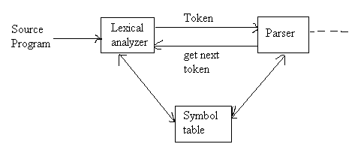
The Role Of The Lexical Analyzer:

Slide 4
Tokens, Patterns and Lexemes:
Tokens: It is basically a sequence of characters that are treated as a unit as it cannot be further broken down.
Ex: In programming languages like C language- keywords (int, char, float, const, goto, continue, etc.) identifiers (user-defined names)
Patterns: It specifies a set of rules that a scanner follows to create a token.
Lexemes: Sequence of characters in the source program that is matched by the pattern for a token.

Slide 5
Tokens, Patterns and Lexeme: const Pi:=3.14
S.No | Lexeme | Token | Pattern
1 | Const | Keyword | Letter followed by letter
2 | Pi | Identifier | Letter followed by letter or digit
3 | := | Operator | Equal to Operator
4 | 3.14 | Constant | Digit followed by dot & digit followed by digit

Slide 6
Specification of Tokens:
Symbols: A symbol can be an alphabet or a digit.
Ex: a, b, 0, *,………
Word or String(W): A group of symbols forms a word or string.
Ex: w=ab, 011………
Є denote empty string.
Length of the string |w|: The number of symbols in a string.
W=abc i.e |w|=3
Language: The term language denotes any set of strings over fixed alphabet.

Slide 7
Regular Expression
The language accepted by finite automata are easily described by simple expressions called regular expressions.
Definition:
1. a) φ is a regular expression that denotes an empty set.
b) Є is a regular expression that denotes the set {Є}.
c) for each ‘a’ in ∑, a is a regular expression that denotes {a}.
2. If ‘r’ and ‘s’ are regular expressions denoting the languages R & S respectively then r+s, rs and r* are regular expressions that denotes the set RUS, RS and R*.

Slide 8
Identities for regular expression:
∅ + r = r
∅.r= r.∅ = ∅
∈.r = r.∈ =r
∈* = ∈ and ∅* = ∈
r + r = r
r*.r* = r*
r.r* = r*.r = r⁺.
(r*)* = r*
∈ +r.r* = r* = ∈ + r.r*
(p.q)*.p = p.(q.p)*
(p + q)* = (p*.q*)* = (p* + q*)*
(p+ q).r= p.r+ q.r and r.(p+q) = r.p + r.q

Slide 9
Regular definitions:
d1 -> r1
d2 -> r2
…
dn -> rn
Example:
letter_ -> A | B | … | Z | a | b | … | Z | _
digit -> 0 | 1 | … | 9
id -> letter_ (letter_ | digit)*

Slide 10
Recognition of tokens
Starting point is the language grammar to understand the tokens:
stmt -> if expr then stmt
| if expr then stmt else stmt
| Ɛ
expr -> term relop term
| term
term -> id
| number

Slide 11
Recognition of tokens (cont.)
The next step is to formalize the patterns:
digit -> [0-9]
Digits -> digit+
number -> digit(.digits)? (E[+-]? Digit)?
letter -> [A-Za-z_]
id -> letter (letter|digit)*
If -> if
Then -> then
Else -> else
Relop -> < | > | <= | >= | = | <>
We also need to handle whitespaces:
ws -> (blank | tab | newline)+

Slide 12
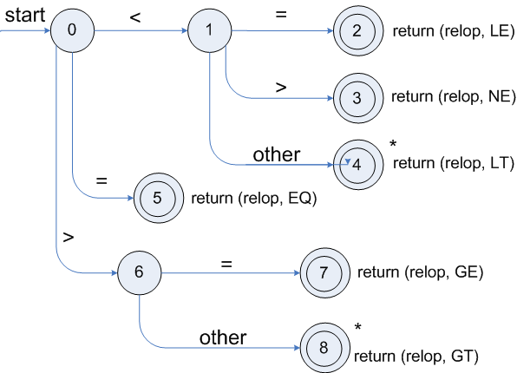
Transition diagrams
Transition diagram for relop

Slide 13
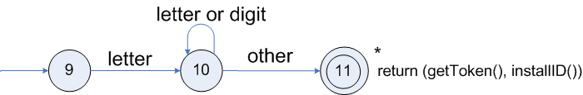
Transition diagrams (cont.)
Transition diagram for reserved words and identifiers

Slide 14
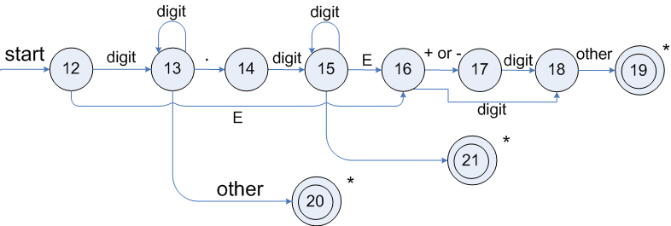
Transition diagrams (cont.)
Transition diagram for unsigned numbers

Slide 15
Implementing of the transition diagram:
int state = 0, start = 0;
int lexical_value;
int fail()
{
forward= token_begining;
switch (start)
{ case 0: start= 9; break;
case 9: start= 12; break;
case 12: start= 20; break;
case 20: start= 25; break;
case 25: return( ); break;
default : /* compiler error */
} return start;
}

Slide 16
token nextotken( )
{
while( 1 )
{
switch ( state )
{
case 0 : c=nextchar( );
if ( c= = blank || c= =newline )
{
state= 0;
lexme_beginning ++;
}
else if ( c = = ‘<’) state = 1;
else if ( c = = ‘=’) state = 5;
else if ( c = = ‘>’) state = 6;
else state= fail( );
break;

Slide 17
case 1: c=nextchar( );
if ( c = = ‘=’) state = 2;
else if ( c = = ‘>’) state = 3;
else state= 4;
break;
case 2: return ( relop , LE ); break;
case 3: return ( relop , NE ); break;
case 4: return ( relop , LT ); break;
case 5: return ( relop , EQ ); break;
case 6: c=nextchar( );
if ( c = = ‘=’) state = 7;
else state= 8;
break;

Slide 18
case 7: : return ( relop , GE ); break;
case 8: : return ( relop , GT ); break;
case 9: c=nextchar( );
if ( isletter( c )) state = 10;
else state= fail();
break;
case 10: c=nextchar( );
if ( isletter( c )) state = 10;
else if ( isdigit ( c )) state = 10;
else state= 11;
break;

Slide 19
case 11 : retract ( 1 );
install-id( );
return ( gettoken ( ));
break;
case 12: c=nextchar( );
if ( isdigit( c )) state = 13;
else state= fail( );
case 13: c=nextchar( );
if ( isdigit( c )) state = 13;
else if ( c= =’ .’ ) state = 14;
else if ( c= = E ) state = 16;
else state= fail( );

Slide 20
case 14: c=nextchar( );
if ( isdigit( c )) state = 15;
else state= fail( );
case 15: c=nextchar( );
if ( isdigit( c )) state = 15;
else if (c= = E) state = 16;
else state= fail( );
break;
case 16: c=nextchar( );
if ( c= =’+’ || c= =’-‘ ) state= 17;
else if ( isdigit( c )) state = 18;
else state= fail( );
break;

Slide 21
case 17: c=nextchar( );
if ( isdigit( c )) state = 18;
else state= fail( );
break;
case 18: c=nextchar( );
if ( isdigit( c )) state = 18;
else if ( c= =other ) state= 19;
else state= fail( );
break;
case 19: return ( num, install_num);
case 20: c=nextchar( );
if ( isdigit( c )) state = 21;
else state= fail( );
break;

Slide 22
case 21: c=nextchar( );
if ( isdigit( c )) state = 21;
else if ( c= =’.’) state= 22;
else state= fail( );
break;
case 22: c=nextchar( );
if ( isdigit( c )) state = 23;
else state= fail( );
break;
case 23: c=nextchar( );
if ( isdigit( c )) state = 23;
else if ( c= =other) state= 24;
else state= fail( );
break;

Slide 23
case 24: return ( num, install_num( ));
case 25: c=nextchar( );
if ( isdigit( c )) state = 26;
else state= fail( );
break;
case 26: c=nextchar( );
if ( isdigit( c )) state = 26;
else state= 27;
break;
case 27: return ( num, install_num( ));
}
}
}

Slide 24
Lexical Analyzer Generator - Lex
Lex Source program
lex.l
Lexical Compiler
lex.yy.c
C
compiler
lex.yy.c
a.out
a.out
Sequence of tokens
Input stream

Slide 25
Lex Specifications:
A Lex program consists of three parts
declarations
% %
translation rules
% %
auxiliary procedures

Slide 26
Translation Rules:
The translation rules of a Lex program are statements of the form
p₁ {action₁}
p₂ {action₂}
………….
p_{n} {action_{n}}

Slide 27
LEX Program:
% {
/* definition of constants
LT, LE, EQ, NE, GT, GE, IF, THEN, ELSE, ID,
NUMBER, RELOP */
}%
/* regular definitions */
delim [\t \n]
ws {delim}+
letter [A-Za-z]
digit [0-9]
id {letter}({letter}|{digit})*
number {digit}+(\.{digit}+)?(E[+/-]?{digit}+)?

Slide 28
%%
{ws} {/* no action and no return */}
if {return(IF);}
then {return(then);}
else {return(else);}
{id} {yylval= install_id( ); return(id);}
{number} {yylval= install_id( ); return(number);}
“<” {yylval= LT; return(RELOP);}
“< =” {yylval= LE; return(RELOP);}
“=” {yylval= EQ; return(RELOP);}
“< >” {yylval= NE; return(RELOP);}
“>” {yylval= GT; return(RELOP);}
“> =” {yylval= GE; return(RELOP);}
%%

Slide 29
install_id( )
{
/* procedure to install the lexeme, whose first character is pointed to by yytext and whose length is yyleng, in to the symbol table and return a pointer there to */
}
install_num( )
{
/* similar procedure to install a lexeme that is a number */
}

